Slide 1
YORM
Cooper Y, Jade O, Maya R, and Dalton M

Slide 2
Overview
Meeting Times: Saturdays 12:00PM - 2:00PM
Dalton:
Macbook Pro, Mac OS
Cooper:
Macbook Pro, Mac OS
Maya:
Macbook Pro, Mac OS
Jade:
Macbook Pro, Mac OS

Slide 3
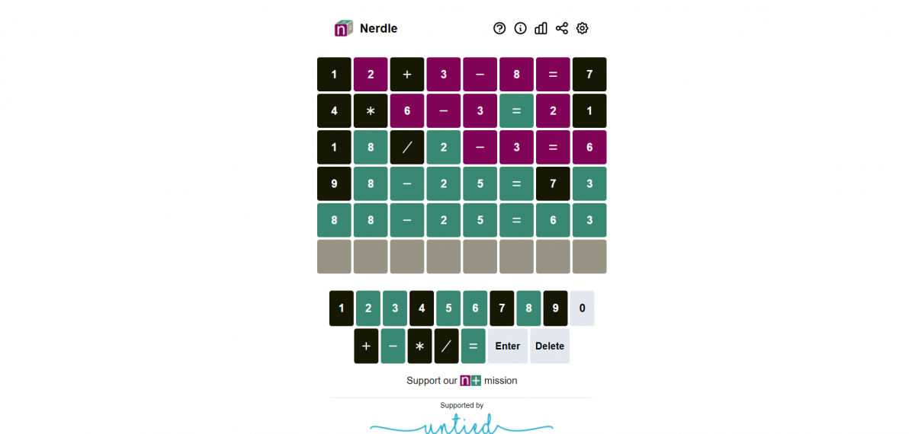
Project Information
We are planning on creating a game “Nerdle”. We plan on implementing this project using a Angular and Node.js frameworks with the end goal of being able to host the working game on GitHub Pages.
“Nerdle” allows the player to guess a math equation using a sequence of numbers and operators. Like “Wordle”, the player continues guessing until they have the correct equation.

Slide 4
Project Information
Technology Stack:
Frontend
Angular
Typescript
Figma (for design)
Backend
Node.js
SQLite
Postman (for testing endpoints)
Tool Chain:
Git
Visual Studio Code
Npm
Postman
GitHub

Slide 5
Past Work Summary
Designed Nerdle webpage in Figma (Cooper)
Researched implementation (Maya)
Installed Node.js and nvm
Installed Angular
Updated the Team README (Dalton)
Made the Checkpoint presentation and tasks for next time (Jade)

Slide 6
Next Checkpoint Plan
Begin working on backend implementation with Node
Variable Storage
Using SQLite – but might not implement a database if not necessary
What do we need to store/what variables do we need the player to be able to communicate with
Page routing
Check using Postman
Validation
Also will use Postman to check return codes
Game plan Backend Services and Unit Testing implementation

Slide 7
Meeting Attendance Sheet
02/03/2024 - All members attended
02/10/2024 - All members attended

Slide 8
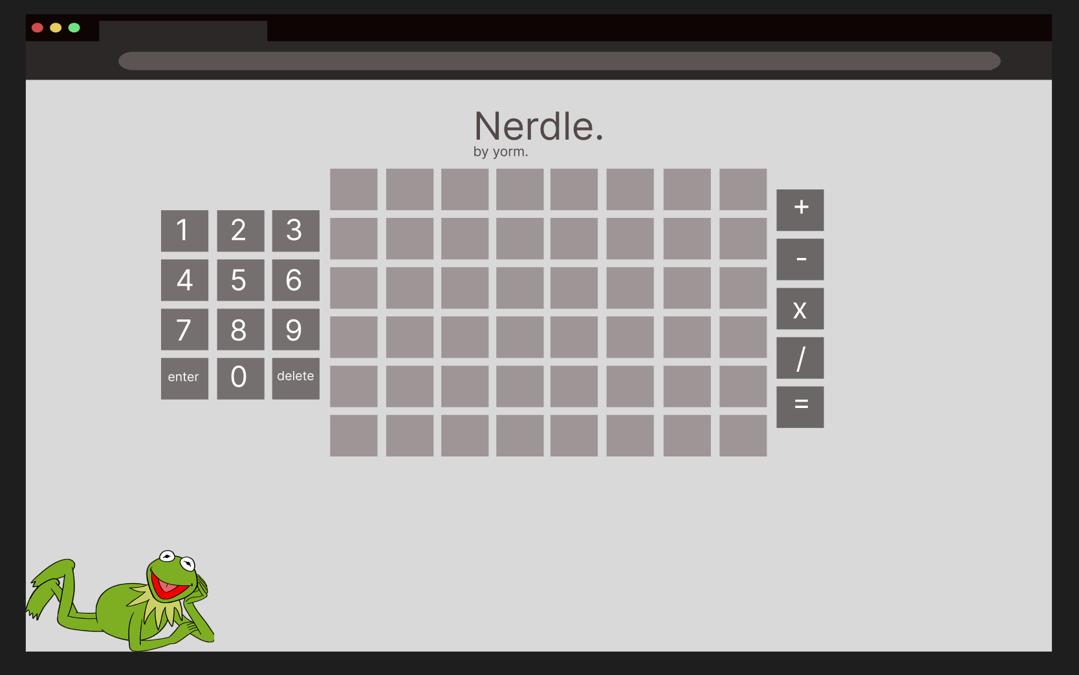
Cooper Young
Created a mockup of the Nerdle game in Figma
Gives the team a plan moving forward and when designing Angular components
Figma Link

Slide 9
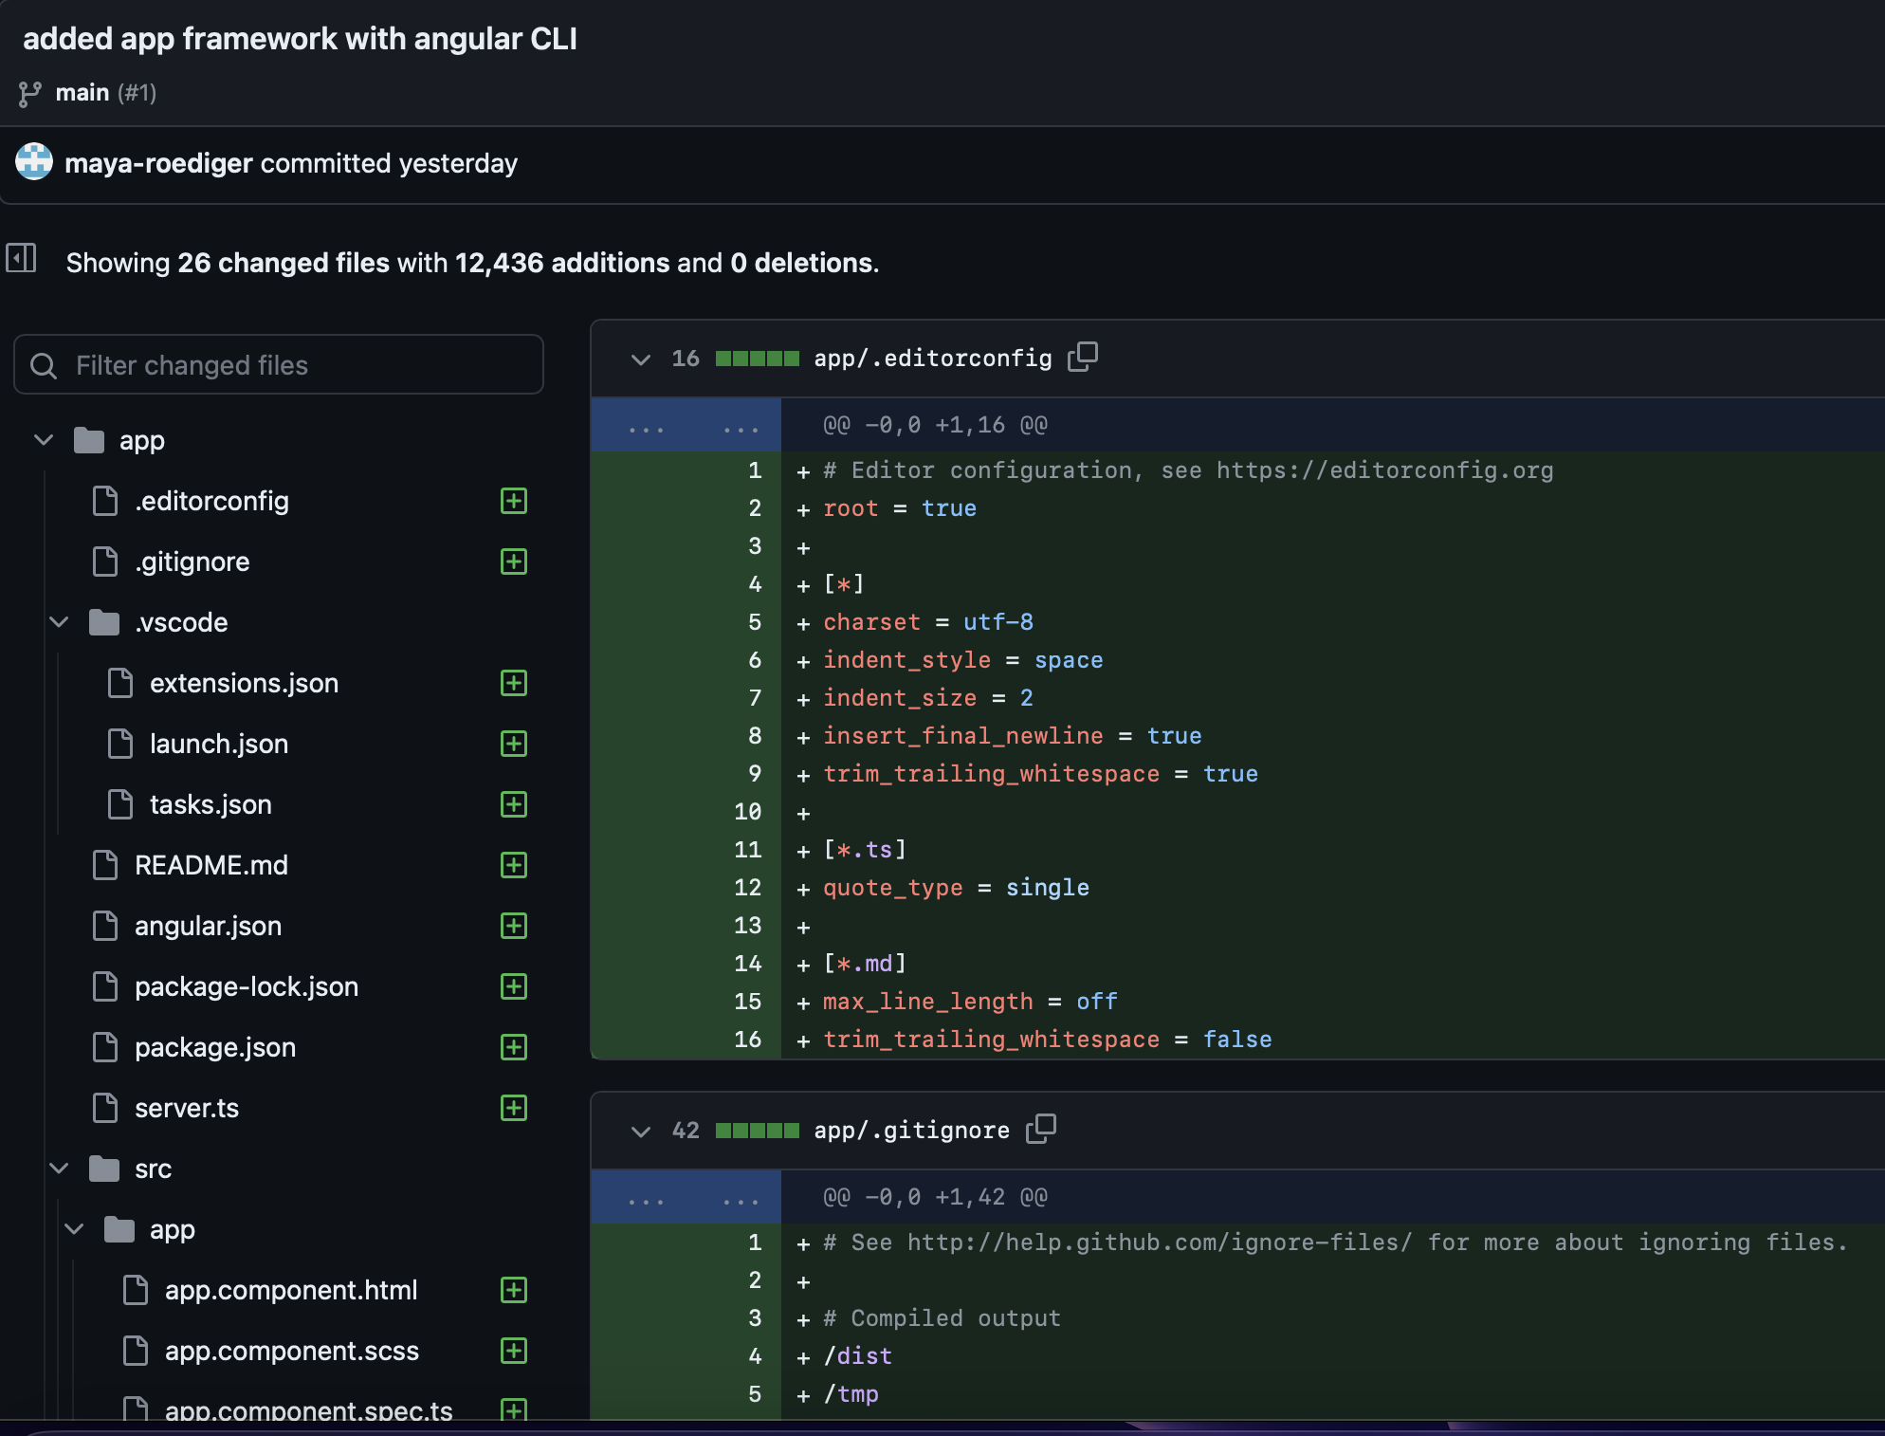
Maya Roediger
Got npm, nvm, and the Angular CLI to function
Used Angular CLI to import framework for a webapp.
Committed to Repo
Link to the entire commit

Slide 10
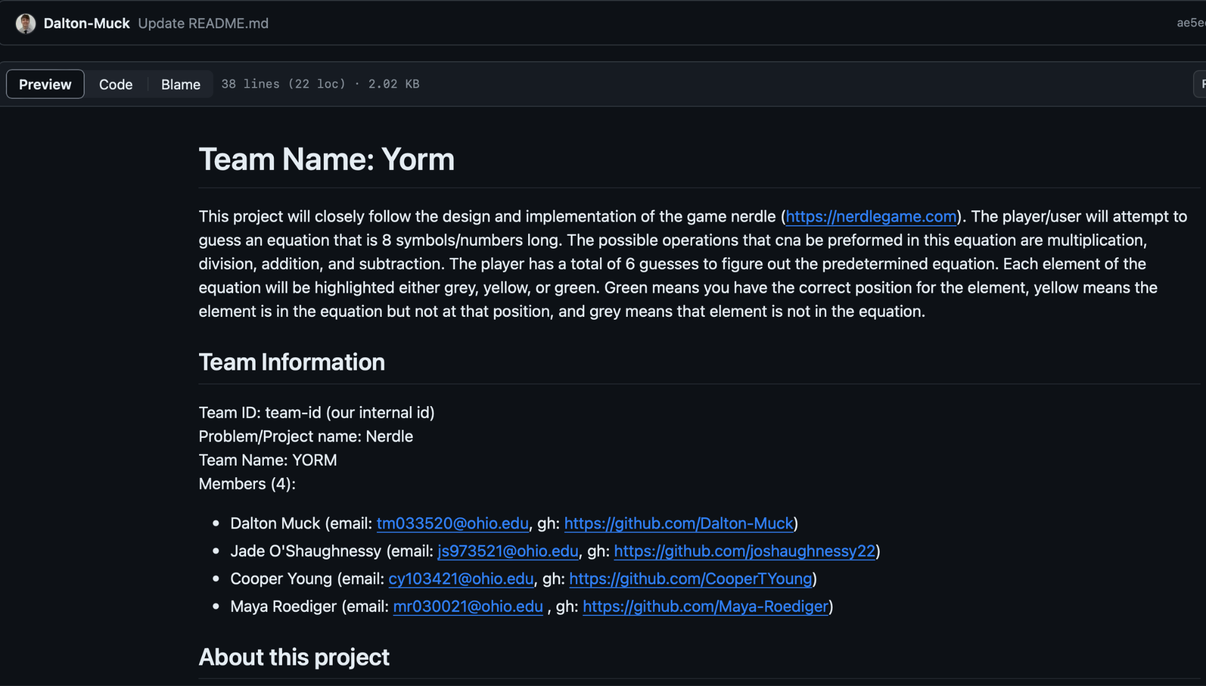
Dalton Muck
Defined team goals, tech stack, and collected team info in an official Readme
Committed to Repo
Link to the README.md

Slide 11
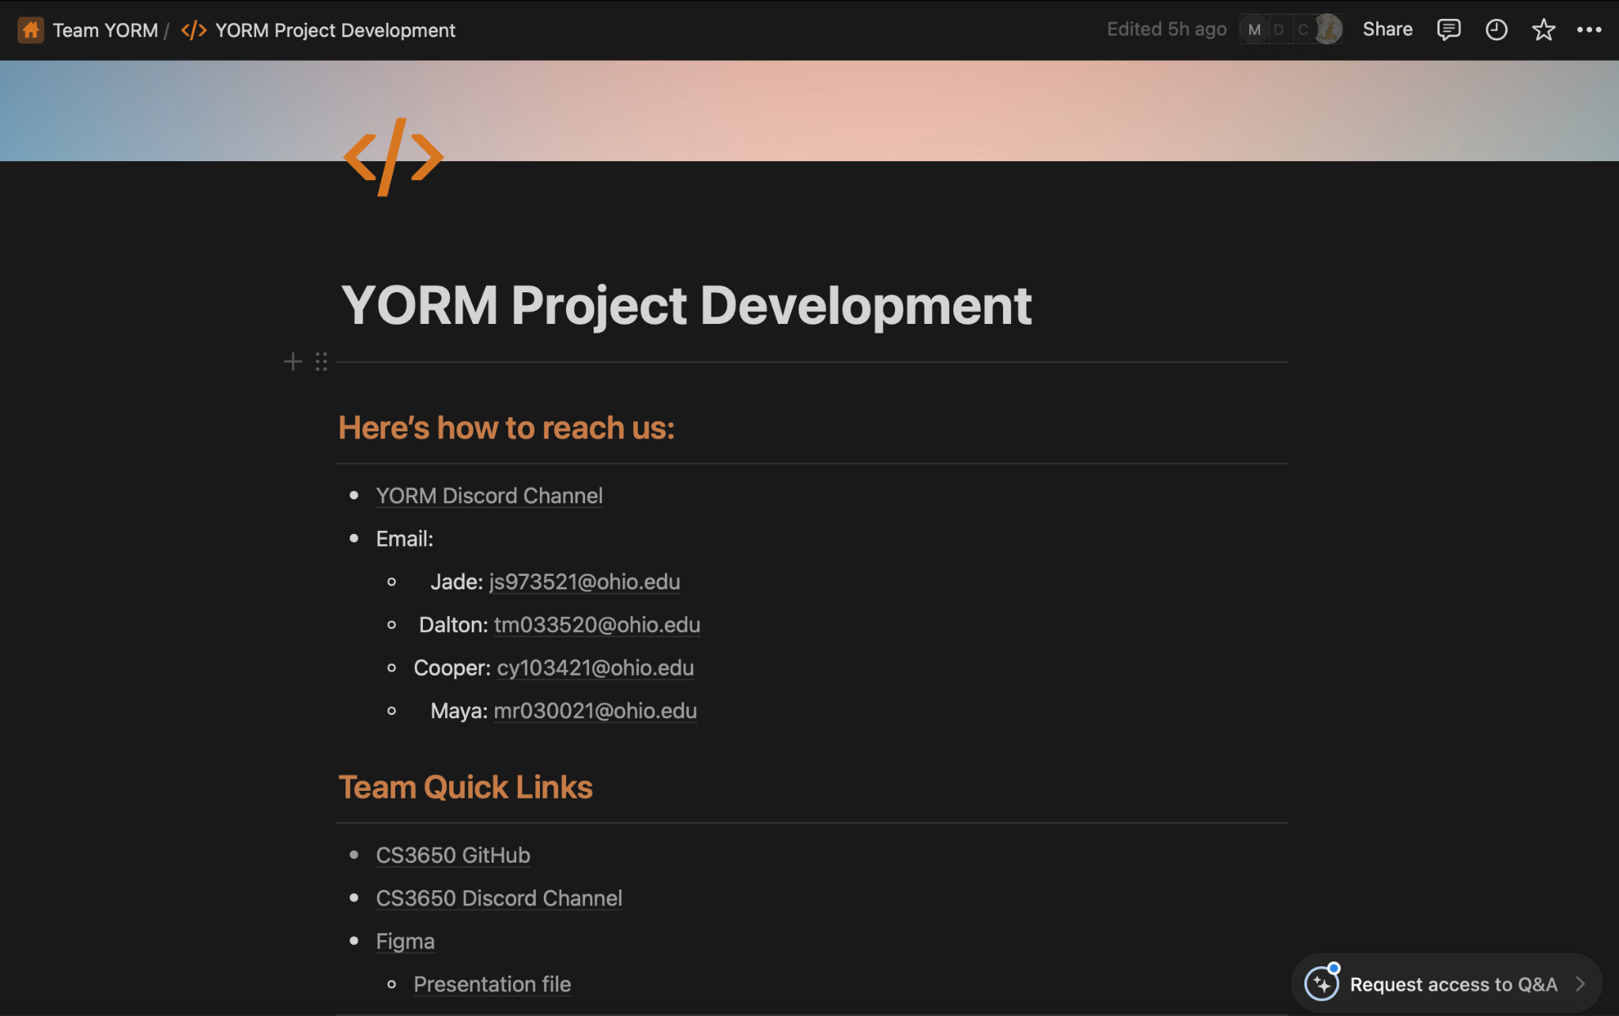
Jade O’Shaughnessy
Set up team plan on Notion
Allows us to track important links and plan tasks
Created team slides for presentation
Outlined plan for the next checkpoint.
Notion Link

Slide 12


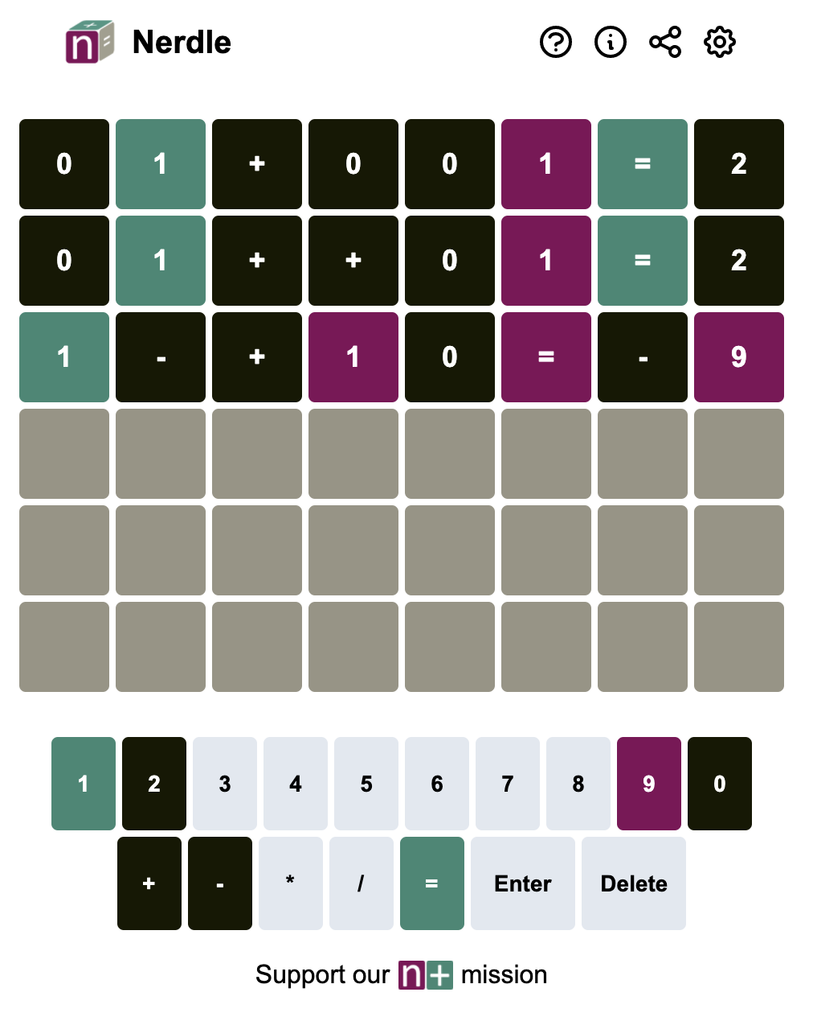
Checkpoint 2
Jade, Maya, Cooper, Dalton

Slide 13
Accomplished:
Web page is running on all machines
Equation generator for Nerdle games
Written in C++
Working Webpage
Ran into errors with Angular imports, so the functions are not connected yet
Keyboard has basic functionality

Slide 14
Project Demo

Slide 15
Next Steps
GOALS:
An equation checker, to check if the user’s input equation is valid
Integrate the equation generator
Integrate Keyboard events into the functionality of the keyboard
Change colors on both board and keyboard (Yellow, Green, Gray)
ROADBLOCKS:
Using typescript
Npm and general angular errors

Slide 16
Grading Feedback

Slide 17
Meeting Times:
Feb. 24th → all attended
Feb. 17th → all attended

Slide 18
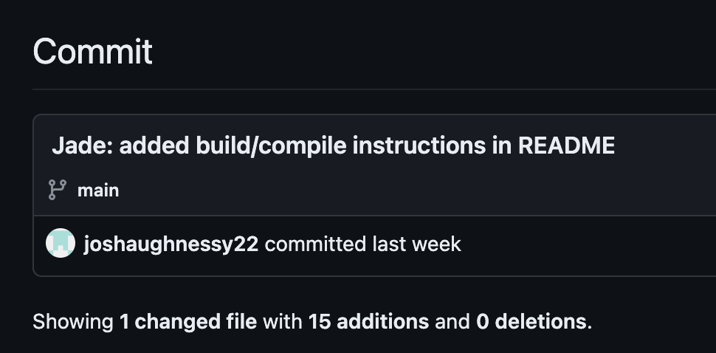
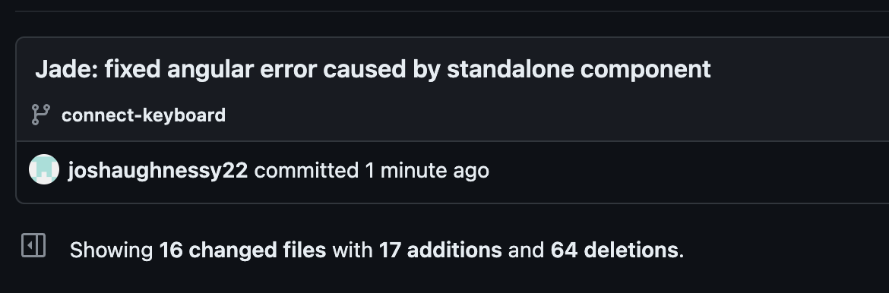
Jade
Updated the README.md to include compiling and starting instructions
https://github.com/OU-CS3560/s24-wordle-fibble-6/commit/80bd18b8abee11585b56127bcd2ec1ad488ef1cc
Fixed compiling error caused by the AppComponent being standalone
https://github.com/OU-CS3560/s24-wordle-fibble-6/commit/bf1696ca5c7240a856c5a20c72f1869b5a2aa650

Slide 19
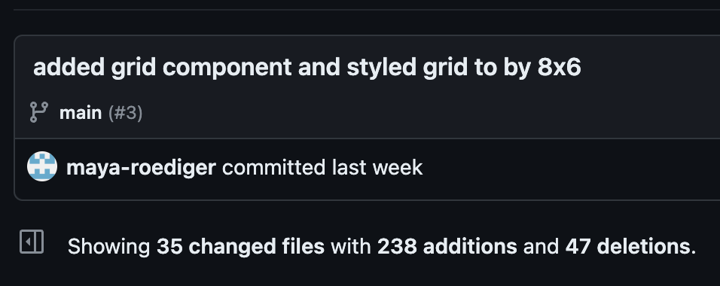
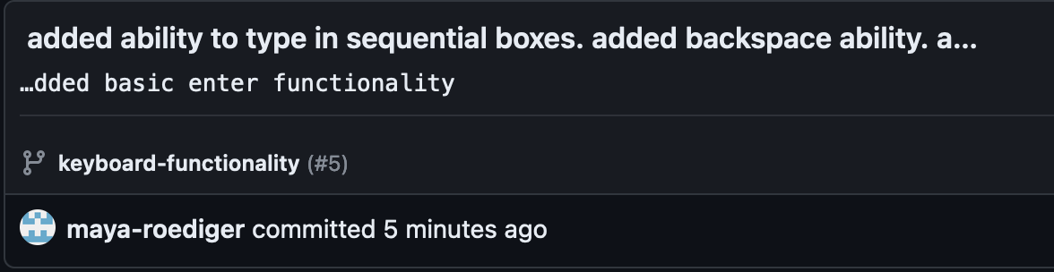
Maya
Created a grid component, styled the grid as 8x6 using SCSS
https://github.com/OU-CS3560/s24-wordle-fibble-6/commit/4f58926407c58fac09f8f892c88b34e3eab9a170
Added some basic keyboard functionality. Pressing a key changes the next box in the row, enter takes you to the next row if the current row is full, and delete removes the last entered character in the row
https://github.com/OU-CS3560/s24-wordle-fibble-6/commit/7dfb7313d5eeefa5cebf06281fb8b68f169c694c

Slide 20
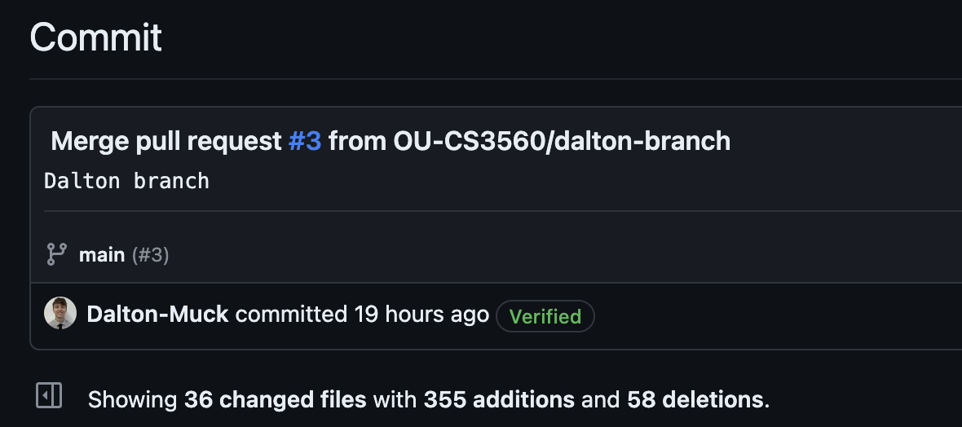
Dalton
Created a keyboard component in the main app component, and merged the branch with main
https://github.com/OU-CS3560/s24-wordle-fibble-6/commit/c4fd76e832f88a02facd9af24c45ce4c5dce3a40#diff-5920c0caee89af009a071636c48b91b99f1e64c3f34008f3ddf804e17aada7e3

Slide 21
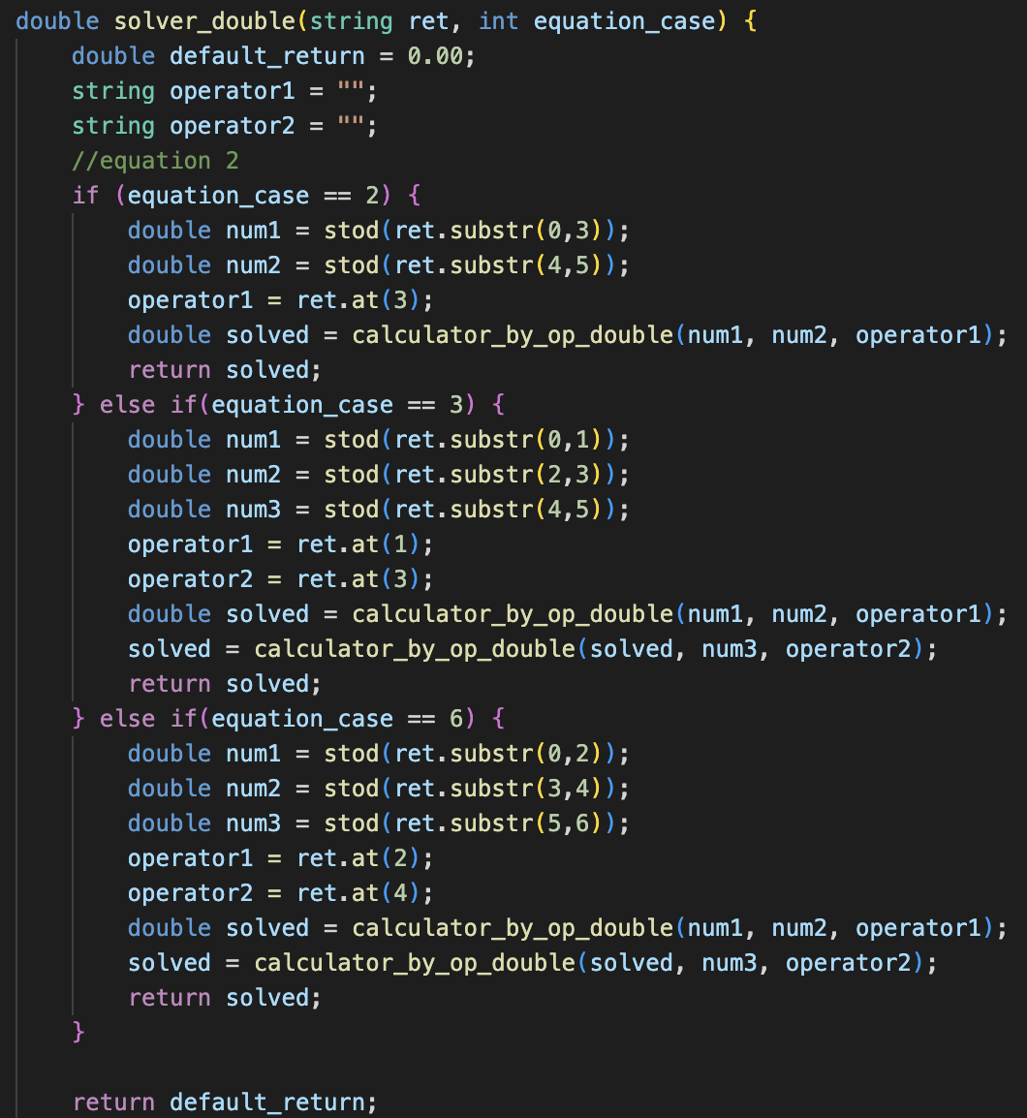
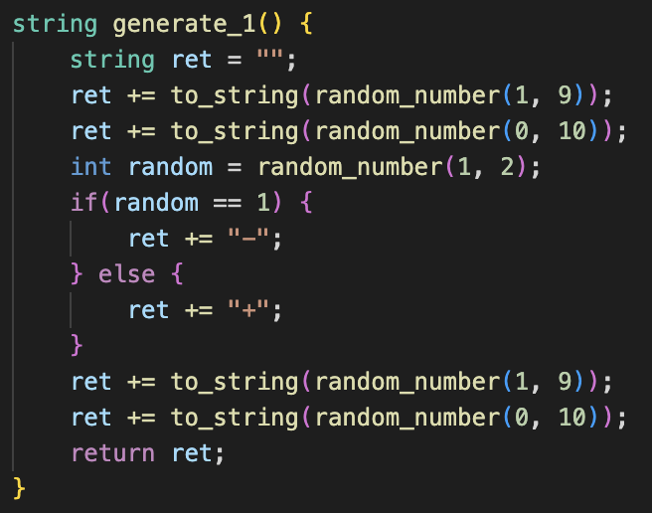
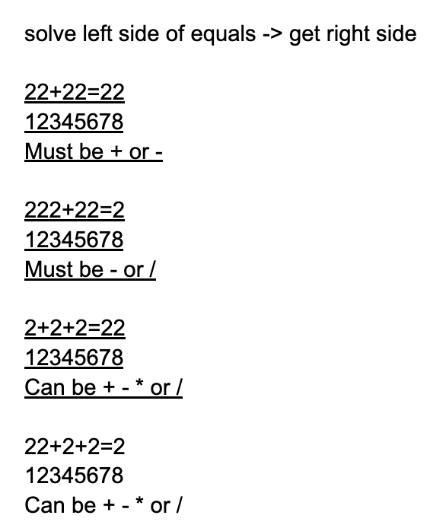
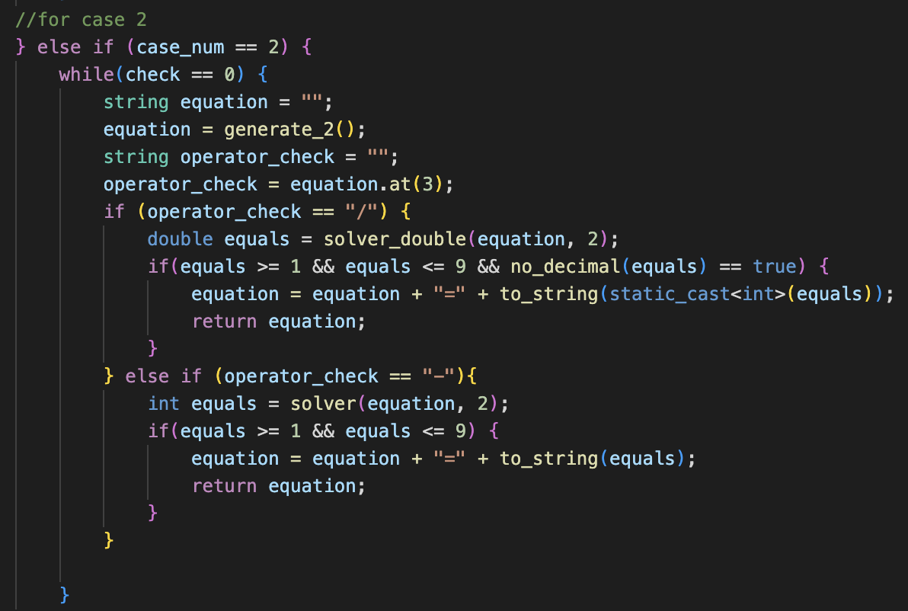
Cooper
Finished almost fully complete prototype of the equation generator
Will eventually return a file with thousands of equations to be picked at random for Nerdle game
Linked to current run of equation generator (only generating 1000 equations and missing some of the equation formats): https://drive.google.com/file/d/1BFon6I3gtSfwrbxfyAJi1oQsx5H-ogCR/view?usp=drive_link

Slide 22
Checkpoint 3
Jade, Maya, Cooper, Dalton

Slide 23
Accomplished:
Almost Fully Functioning C++ code for creating equations
Fully Functional keyboard and buttons
Better Formatting Color classes for each guess
Functioning color Checker
Blue: Right character, wrong space
Green: Right character, right space
Grey: Wrong

Slide 24
Project Demo

Slide 25
Next Steps
GOALS:
Fully Integrate the C++ Equation Checker and the Nerdle App
Make logic for yellow boxed guesses correct
Add additional features/ clean up the webpage
Dark Mode
Different color combos
Spin-off games
Check for Validity of User Guess
How to play
ROADBLOCKS:
Using typescript
Npm and general angular errors
Building off code written by teammates

Slide 26
Grading Feedback

Slide 27
Meeting Times:
March 2nd→ all attended
March 7th → all attended

Slide 28
Git- tracks changes to source code and is used for version control
GitHub- helps manage the git repository
Visual Studio Code- editor that hosts code and helps debug
NPM (Node Package Manager- holds code packages used in project
Google Chrome Dev- used to view real-time effects of the different components and functions, allows to see changes “on the fly”
Codespaces- runs github repo instantly allows for multiple versions of same branches
Figma- Visualization tools for desired product at end
EsLint- used to run static code analysis trials, security testing
Angular CLI- framework for initialize, develop, and maintains application form command shell
Tool Stack

Slide 29
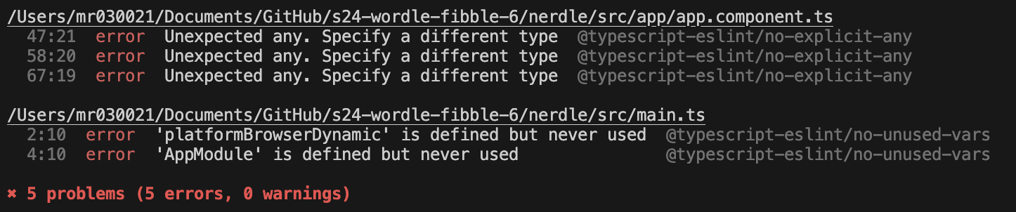
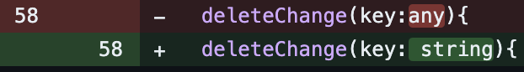
Static Analysis of our WebApp
We used EsLint through the Angular CLI to do static analysis of our WebApp
EsLint detected some incorrect usages of any in the declarations of our keyboard functions
This was enlightening and made us change those types
EsLint also detected that we were not using some definitions in the main.ts file
This was not as large a concern for us because we are not completely done with our implementation

Slide 30
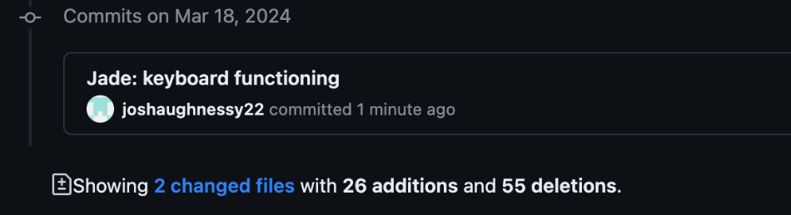
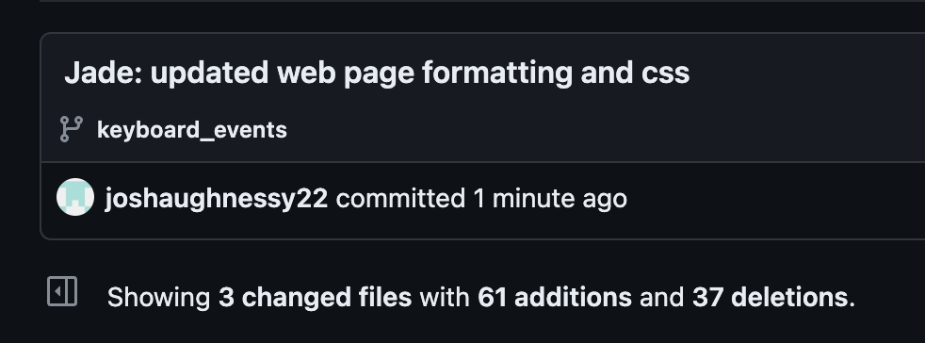
Jade
Created Keyboard_events branch and implemented functionality of keyboard
https://github.com/OU-CS3560/s24-wordle-fibble-6/compare/main...keyboard_events
Updated web page formatting
https://github.com/OU-CS3560/s24-wordle-fibble-6/commit/762adc9def01f5e67b1a7e8f6b3b92c8672985bc

Slide 31
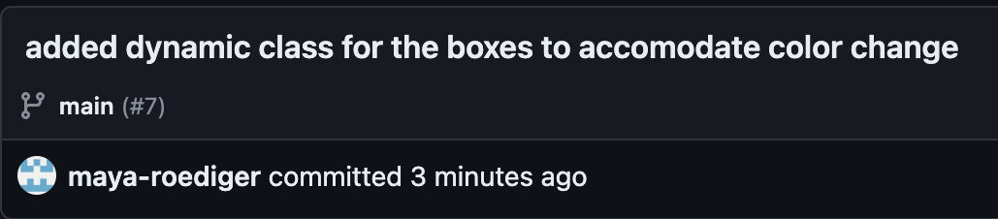
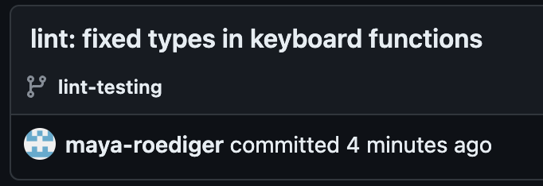
Maya
Added a dynamic class system for the boxes so that the color actually changes when the guess is submitted
https://github.com/OU-CS3560/s24-wordle-fibble-6/commit/ac84a7f8d30af7ea03a7f471373a82a71148f9f4
Lots of trial and error with different ways of changing the class
Figured out how to use EsLint through the Angular CLI and fixed type errors
https://github.com/OU-CS3560/s24-wordle-fibble-6/commit/e87b43ed9ca9ff4655eabb2393c1a55c0073c4ab

Slide 32
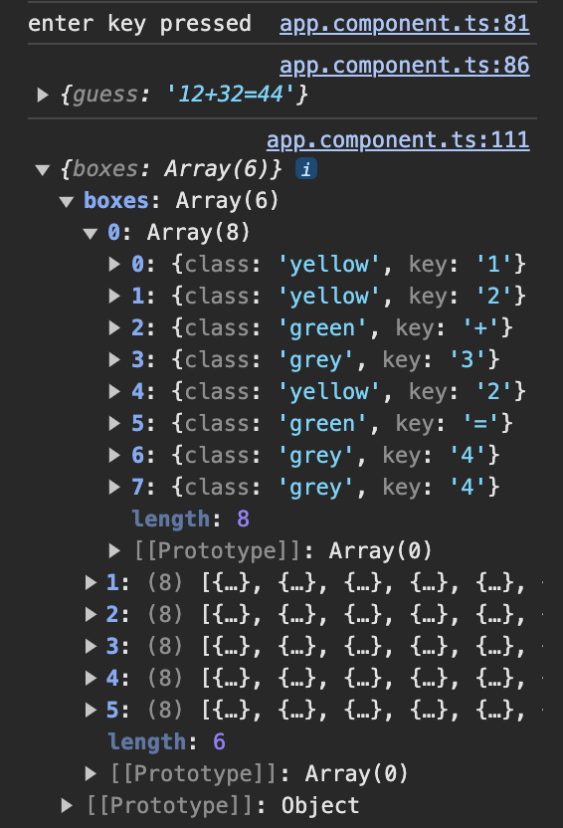
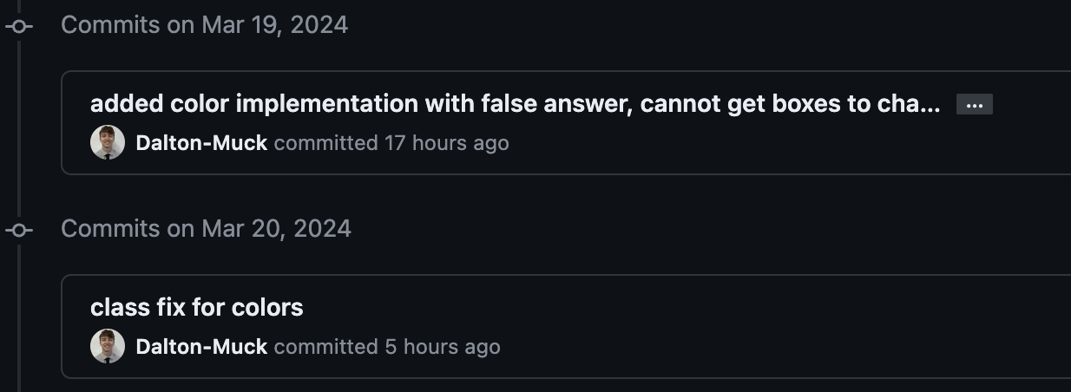
Dalton
Made logic that links each guess’s digits to their correct background-color
https://github.com/OU-CS3560/s24-wordle-fibble-6/compare/main...color-implementation
Cleaned up main after all additions were made (visual changes, commenting/deleting old code, and fixing small bugs)

Slide 33
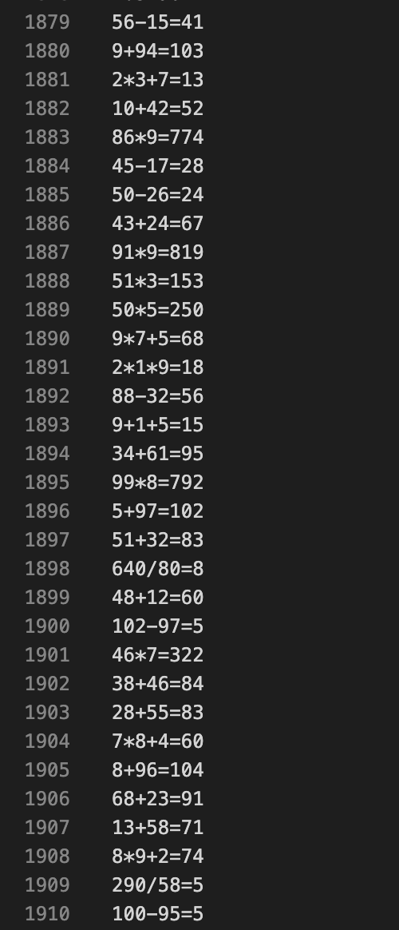
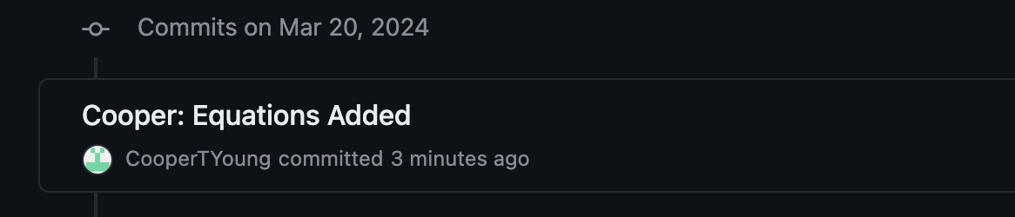
Cooper
Finished Equation Generator
Added text file with 5000 random equations: https://drive.google.com/file/d/1GatgqmFnQSLhPQAQqGkNH3p01MWq9y20/view?usp=sharing

